Slide 1


Modelling Dojo
Spring 2018
Notes:
Machine learning

Slide 2
“Demand For Data Scientists up 28 % by 2020 since 2017”
https://www.forbes.com/sites/louiscolumbus/2017/05/13/ibm-predicts-demand-for-data-scientists-will-soar-28-by-2020/
Notes:
For our clients
Up to date
Modeling is seen as core component to unlock value in data

Slide 3
Today:
Starting point for discussion with common language
Learning and growth opportunity at all levels

Slide 4
Modeling Dojo: Disclaimer / Expectations
We will try to keep explanation at a high-level
We will define all terms (no jargon please!)
Please ask questions
Everyone in this room should learn something today
Notes:
http://time.com/4461455/how-to-become-expert-at-anything/

Slide 5
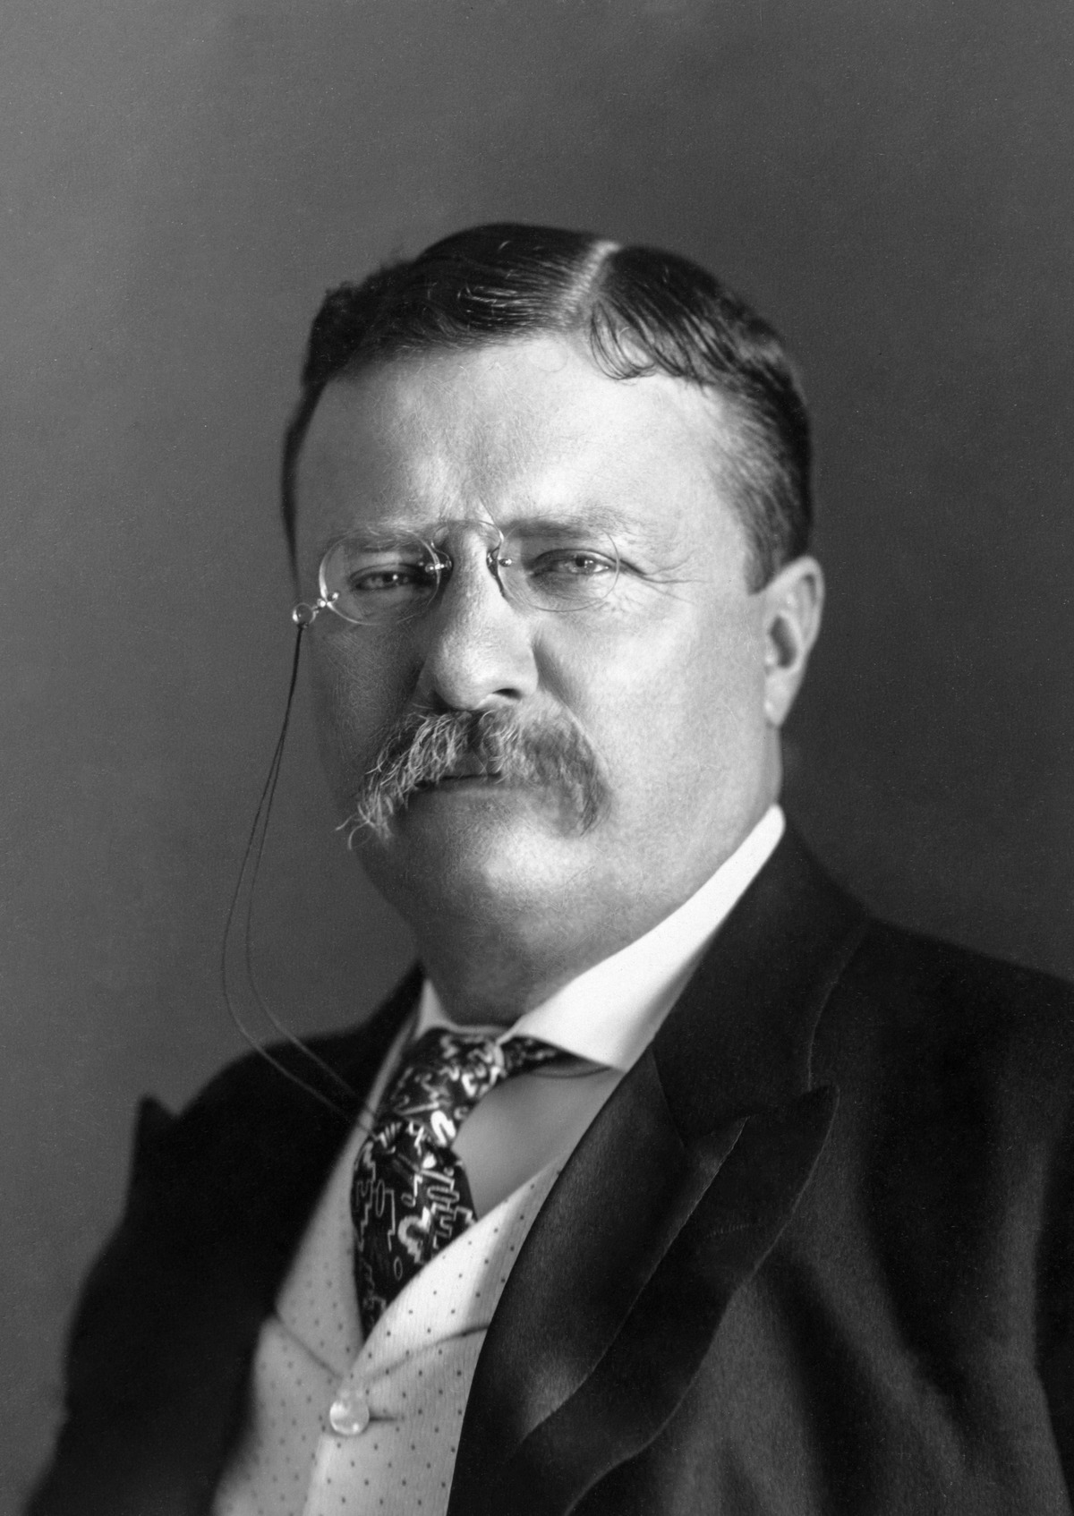
“It is not the critic who counts; not the man who points out how the strong man stumbles, or where the doer of deeds could have done them better.
The credit belongs to the man who is actually in the arena, whose face is marred by dust and sweat and blood; who strives valiantly; who errs, who comes short again and again, because there is no effort without error and shortcoming; but who does actually strive to do the deeds; who knows great enthusiasms, the great devotions; who spends himself in a worthy cause; who at the best knows in the end the triumph of high achievement, and who at the worst, if he fails, at least fails while daring greatly, so that his place shall never be with those cold and timid souls who neither know victory nor defeat.”
-- Theodore Roosevelt
Excerpt from the speech "Citizenship In A Republic"
Sorbonne, Paris, France
23 April, 1910

Slide 6
Modeling: What, Why, How
26th March 2018
Jon Downing
Notes:
Language

Slide 7
Modeling: What
model (noun)
“A simplified description, especially a mathematical one, of a system or process, to assist calculations and predictions.”
-- Oxford English Dictionary

Slide 8
Modeling: What
model (noun)
“A simplified description, especially a mathematical one, of a system or process, to assist calculations and predictions.”
-- Oxford English Dictionary
1. Observation (data)

Slide 9
Modeling: What
model (noun)
“A simplified description, especially a mathematical one, of a system or process, to assist calculations and predictions.”
-- Oxford English Dictionary
1. Observation (data)
2. Predict future observations

Slide 10
Modeling: What
model (noun)
“A simplified description, especially a mathematical one, of a system or process, to assist calculations and predictions.”
-- Oxford English Dictionary
1. Observation (data)
2. Predict future observations
3. Understand limitation

Slide 11
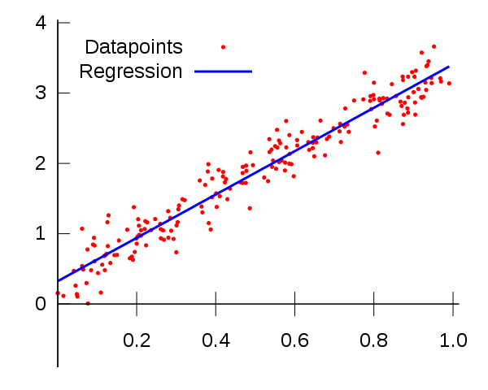
Modeling: Regression (single variable)

Slide 12
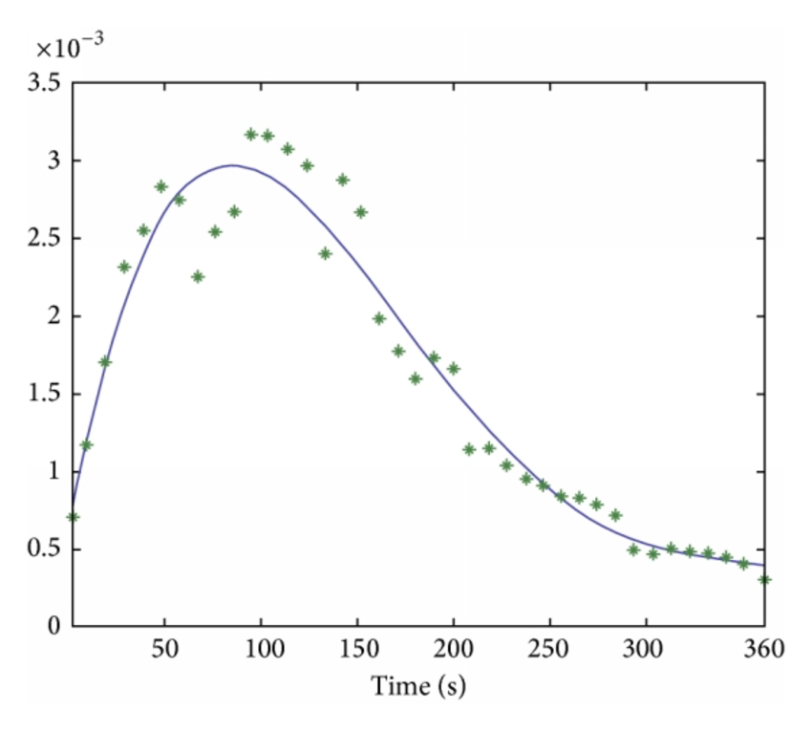
Note: Correlation may not be linear

Slide 13
There are many examples of correlation
Height α Weight

Slide 14
There are many examples of correlation
Height α Weight
Size of left foot α Size of right foot

Slide 15
There are many examples of correlation
Height α Weight
Size of left foot α Size of right foot
Sugar consumption α Likelihood of diabetes

Slide 16
There are many examples of correlation
Height α Weight
Size of left foot α Size of right foot
Sugar consumption α Likelihood of diabetes
Being rich α Likelihood of getting into Harvard

Slide 17

Complex Examples with multiple variables

Slide 18
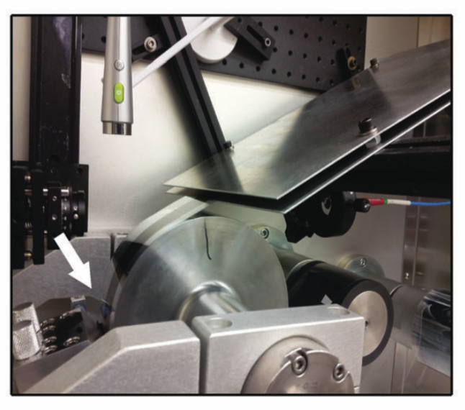
Printing solar cells from plastic
Richter et al. In Situ Morphology Studies of the Mechanism for Solution Additive Effects on the Formation of Bulk Heterojunction Films Adv. Energy Mater. 2014, 1400975

Slide 19
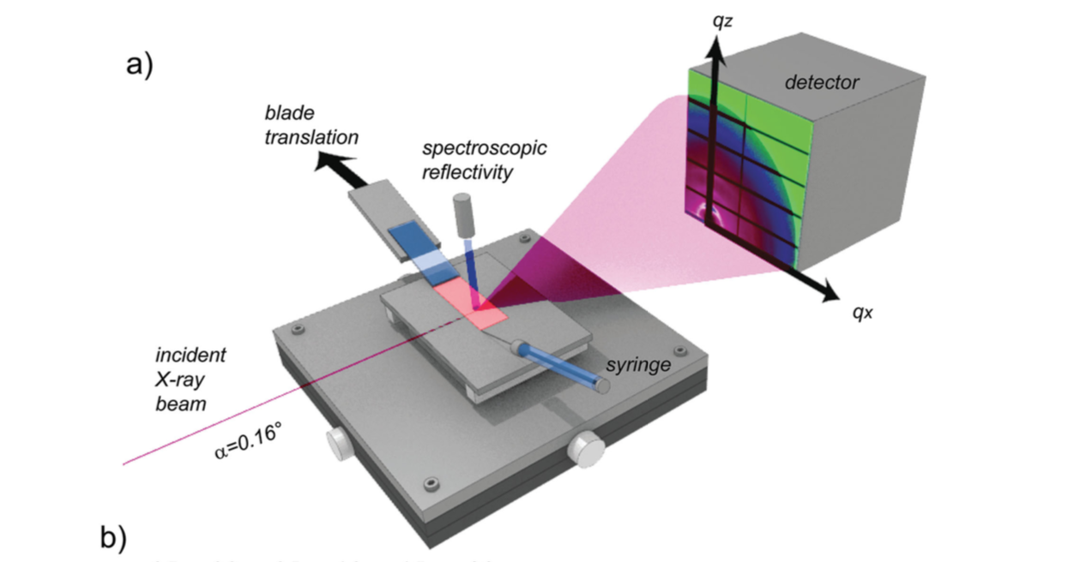
Complex experiments enable drying behaviour to be observed
Richter et al. In Situ Morphology Studies of the Mechanism for Solution Additive Effects on the Formation of Bulk Heterojunction Films Adv. Energy Mater. 2014, 1400975

Slide 20
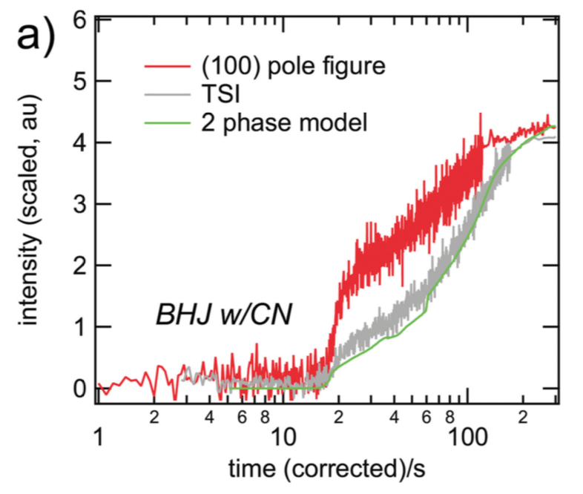
Model allows drying behaviour to be understood
Richter et al. In Situ Morphology Studies of the Mechanism for Solution Additive Effects on the Formation of Bulk Heterojunction Films Adv. Energy Mater. 2014, 1400975

Slide 21
Other scientific examples with multiple variables
Solar panel efficiency α
solvent, polymer type, solution concentration, temperature

Slide 22
Other scientific examples with multiple variables
Solar panel efficiency α
solvent, polymer type, solution concentration, temperature
Reaction rate α
temperature, reaction profile, catalyst action

Slide 23
Other scientific examples with multiple variables
Solar panel efficiency α
solvent, polymer type, solution concentration, temperature
Reaction rate α
temperature, reaction profile, catalyst action
Climate change α
CO₂, SO₂, CH₄ concentration, land use, energy use, weather patterns, glacial melt rate…

Slide 24
Work Valtech teams have completed
Likelihood of link between public records α
Field comparison by different metrics: Levenshtein string distance, n-grams, strings within strings

Slide 25
Work Valtech teams have completed
Likelihood of link between public records α
Field comparison by different metrics: Levenshtein string distance, n-grams, strings within strings
Identify address from string
α
Presence of common strings (company, road, location, ordinal),
word order, punctuation

Slide 26
Modeling: Why
1. Observation (data)
→
2. Predict future observations
Notes:
A predictor is a function f that maps an input x to an output y

Slide 27
Modeling: Why
1. Observation (data)
→
2. Predict future observations
Abstraction of relationships within the data (given noise)
Notes:
A predictor is a function f that maps an input x to an output y

Slide 28
Modeling: Why
A predictor is a function f that maps an input x to an output y
Notes:
A predictor is a function f that maps an input x to an output y

Slide 29
Modeling: Be careful with uncertainty
“It is far better to foresee even without certainty than not to foresee at all.”
--Henri Poincare (chaos theory)
The Foundations of Science, page 129.

Slide 30
Modeling: All Models are Wrong, Some are Useful
“For such a model there is no need to ask the question Is the model true?". If "truth" is to be the "whole truth" the answer must be "No".
The only question of interest is "Is the model illuminating and useful?".”
-- George E. P. Box
Robustness in the strategy of scientific model building
Robustness in Statistics, Academic Press, pp. 201–236, 1979
Notes:
We’ll come back to Box

Slide 31
Modeling: How

Slide 32
Modeling: How
Model reduces the complexity of the real system through a simplified description using a finite number of variables.

Slide 33
Modeling: How
Model reduces the complexity of the real system through a simplified description using a finite number of variables.

Slide 34
Jargon: Important Definitions
Variable: A quantity able to assume different numerical values

Slide 35
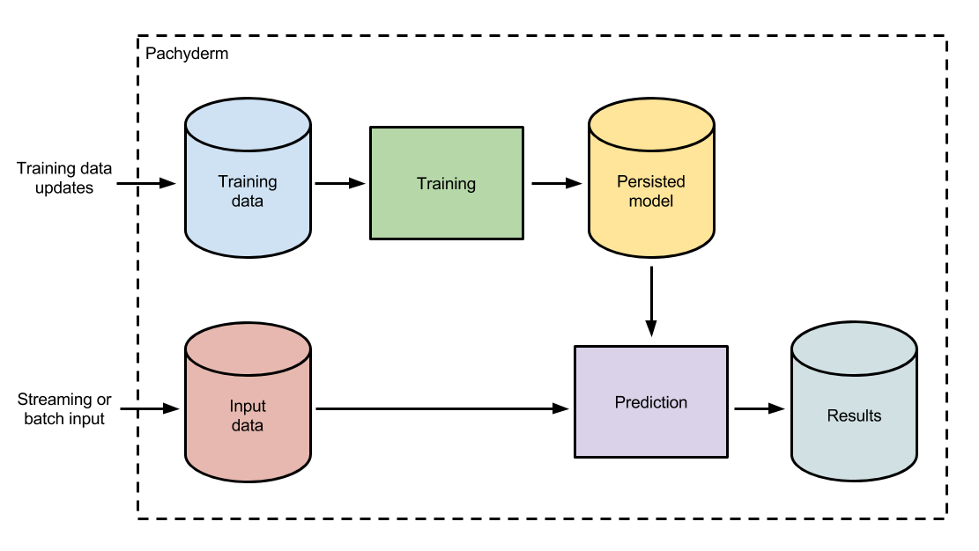
Modeling: Modeling Machine Learning
Notes:
We can over complicate things with large diagrams

Slide 36
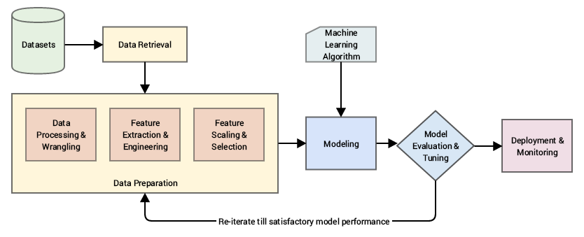
Modeling: Modeling Machine Learning
Notes:
This one is complex too

Slide 37
Modeling: Box’s Loop
Data
Model
Infer
Criticize
Box, G. and Hunter, W. (1962). A useful method for model-building. Technometrics, 4(3) 301–318
Blei, David M. “Build, compute, critique, repeat: Data analysis with latent variable models.” Annual Review of Statistics and Its Application 1 (2014): 203-232
Notes:
Speed of loop!
This is better

Slide 38
Modeling: Box’s Loop
Data
Sample data
Model, Build
Infer
Criticize
Box, G. and Hunter, W. (1962). A useful method for model-building. Technometrics, 4(3) 301–318
Blei, David M. “Build, compute, critique, repeat: Data analysis with latent variable models.” Annual Review of Statistics and Its Application 1 (2014): 203-232
Notes:
Actually more like this

Slide 39
Steps in Box’s Loop
Setup model using observed data
Train / build model
Conduct inference / prediction
Critique model
Feedback: If satisfied with model performance, use model. If not satisfied, go back to 1.
Notes:
Each step is not easy!

Slide 40
Step 1. Setup Model / Train / build model
Cast model / machine learning as an optimization problem:
Model + Loss function = Optimisation problem
Use an Optimisation algorithm to solve
Iterative: For example (Stochastic) gradient descent
Heuristic: For example Genetic Algorithms
Find weights / latent / hidden variables
Move on to next step
Notes:
Setup takes the most time

Slide 41
Jargon: Important Definitions
Variables: A quantity able to assume different numerical values
Latent Variables / Hidden Variables: Variables that are not directly observed but are rather inferred (through a mathematical model) from other variables that are observed (directly measured).
Loss function: A loss function Loss(x, y, w) quantifies how unhappy you would be if you used w to make a prediction on x when the correct output is y.
Heuristic: proceeding to a solution by trial and error or by rules that are only loosely defined.

Slide 42
Modeling: Box’s Loop
Data
Sample data
Model, Build
Infer
Criticize
Box, G. and Hunter, W. (1962). A useful method for model-building. Technometrics, 4(3) 301–318
Blei, David M. “Build, compute, critique, repeat: Data analysis with latent variable models.” Annual Review of Statistics and Its Application 1 (2014): 203-232

Slide 43
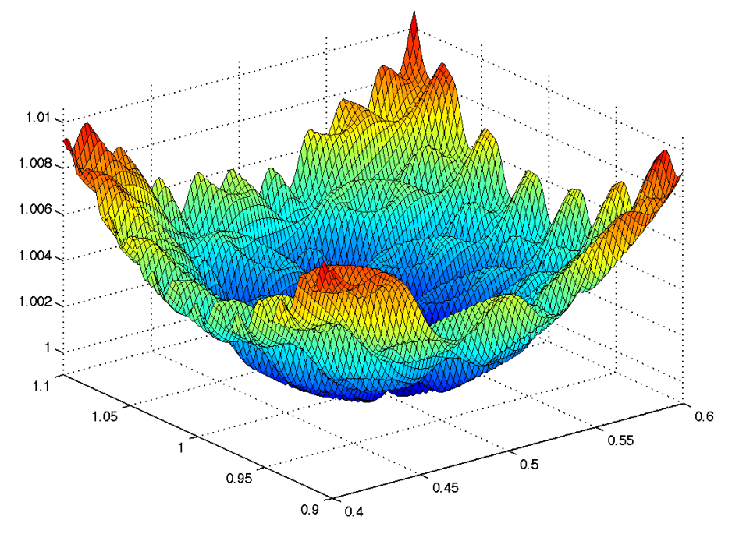
Notes:
Optimisation finds the values of hidden or latent variable in a complex space

Slide 44
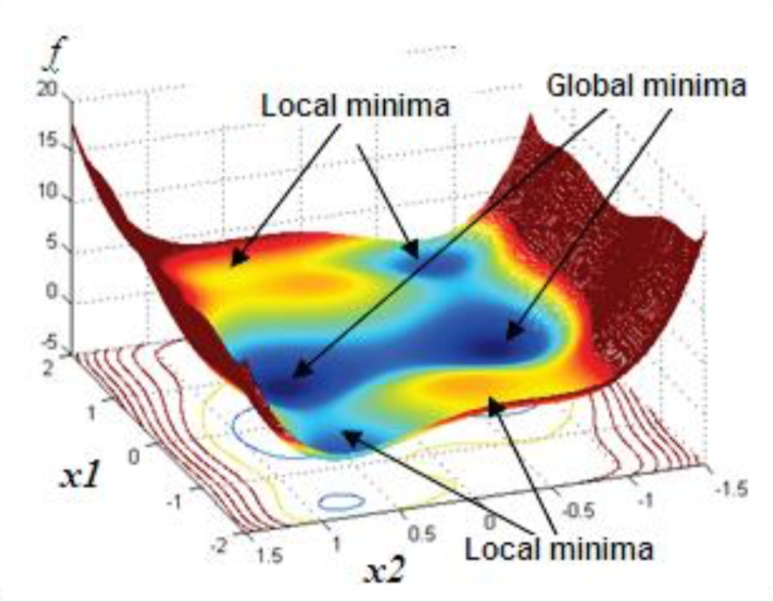
NB: In reality optimizing for more variable than 2! (10² → 10⁶)
Notes:
We are hoping to find global minima

Slide 45
Step 1. Setup Model / Train / build model
Sample data
What to optimised for?
(a loss function)
How to optimise?
(an optimisation algorithm)
Create model:
MVP
What are the available inputs?
What are the desired outcomes?
Which assumptions are required?
Model

Slide 46
Step 1. Setup Model / Train / build model
Sample data
What to optimised for?
(a loss function)
How to optimise?
(an optimisation algorithm)
Create model:
MVP
What are the available inputs?
What are the desired outcomes?
Which assumptions are required?
Clean data, structure and create features
Requires domain expertise
See Mikayel’s deck on data exploration
Model

Slide 47
Step 1. Setup Model / Train / build model
Sample data
What to optimised for?
(a loss function)
How to optimise?
(an optimisation algorithm)
Model
3) Use sample data to train model
Find the optimal of the latent variables
Run optimisation algorithm
Optimisation algorithms discussed more later talks
Requires understanding of optimisation algorithm and parameters: Computation time vs accuracy
Notes:
Various parameters to tune

Slide 48
Step 2. Conduct inference / prediction
Run the model!
To avoid over-fitting use data the model has not yet ‘seen’ (hold-out data set)
Data
Infer

Slide 49
Step 3. Criticism
Note / Caveat: We are trying to make the model be the best version of itself, not comparing it to other models

Slide 50
Step 3. Criticism
Verification: A model matches its design
“To check, confirm or prove the truth of something. To establish, prove, substantiate, attest, corroborate, support, confirm.”

Slide 51
Step 3. Criticism
Verification: A model matches its design
“To check, confirm or prove the truth of something. To establish, prove, substantiate, attest, corroborate, support, confirm.”
Validation: A model matches the data
“To meet some criteria associated with the model and or the data /observations.”

Slide 52
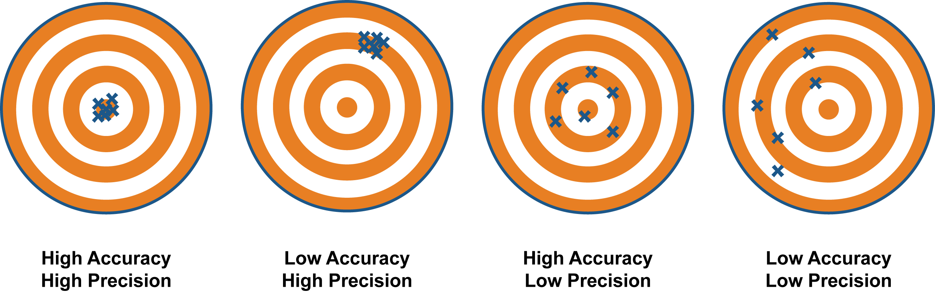

Slide 53
Step 3. Criticism
A model can be regarded valid if it is able to provide information on the function of a real system sufficiently near to those obtained by experiment or observation.
Notes:
Classification: misclassification rate (Receiver operating characteristic curve

Slide 54
Step 3. Criticism
A model can be regarded valid if it is able to provide information on the function of a real system sufficiently near to those obtained by experiment or observation.
Unfortunately the concept of validity is not universal!
How to decide if model ‘right’ / ‘good enough’?
How long is a piece of string..
Validate ‘goodness-of-fit’ / look for the error
Notes:
Classification: misclassification rate (Receiver operating characteristic curve

Slide 55
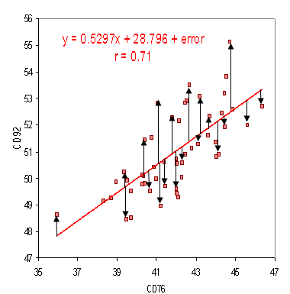
Step 3. Criticism
Pick a metric (or many!)
Find out how much it is wrong
Metrics depend on the type of model:
Classification: misclassification rates (TP, FP, TN, FN) (precision, recall)
Regression: Mean squared error (MSE)
Posterior Predictive Checks: Take the fitted model and using it to simulate replicated data, use these to compared to the observed dataset
3. Understand limitation

Slide 56
Step 4. Feedback
Use metrics / criticism to improve the model:
Possible options:
Alter the training set
Enlarge the number of variables / features
Change the optimisation method
Change the loss function
Change the model structure

Slide 57
Step 4. Feedback
Use metrics / criticism to improve the model:
Possible options:
Alter the training set
Enlarge the number of variables / features
Change the optimisation method
Change the loss function
Change the model structure
Inherent trade off between
complexity and accuracy / precision

Slide 58
Modeling: What
model (noun)
“A simplified description, especially a mathematical one, of a system or process, to assist calculations and predictions.”
-- Oxford English Dictionary
1. Observation (data)
2. Predict future observations
3. Understand limitation

Slide 59
Summary
What is modeling:
Defined modeling
Examples
Why model:
Understand observations
Predict future observations
How to model:
Follow Box’s loop
Model, Infer, Criticise, Feedback
Notes:
This is what we’ve learned

Slide 60

Questions, Comments, Concerns?

Slide 61
-- End --

Slide 62
Changing workflows open the doors to total error estimates…
Measurement
X±σ_{X}
Estimate of Total Error
on Measurement
Notes:
More about running a data pipeline than modelling

Slide 63
…which allows for optimisation
Error
Variations
Measurement
X±σ_{X}
Estimate of Total Error
on Measurement
Notes:
Optimisation of data pipeline variables

Slide 64
…to suggest what to send to production
Production
Notes:
Once optimised then move to production

